Slide 1
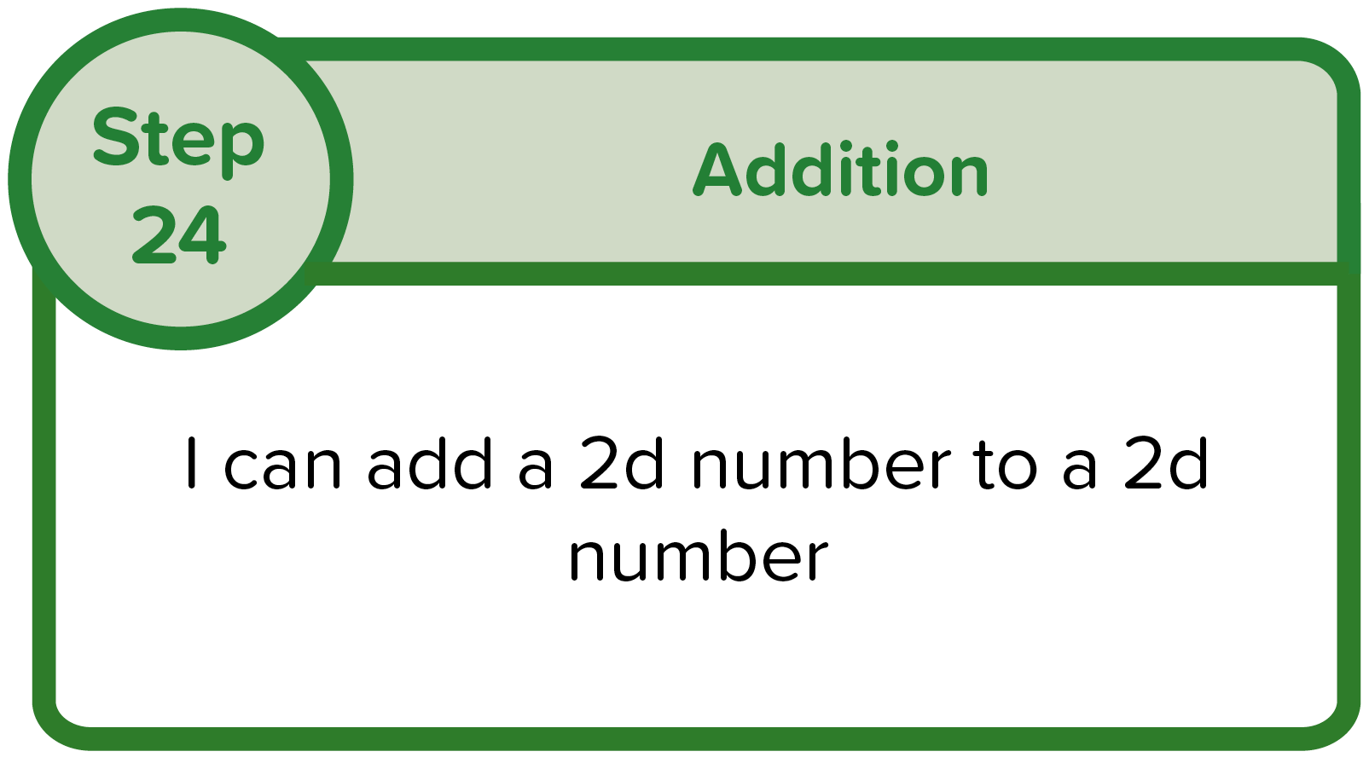
Remember To:
partition the numbers
write out the 2 new questions
add the ones
add the tens
add the ones answer to the tens answer
Example 1

Slide 2
Get your whiteboards ready!

Slide 3
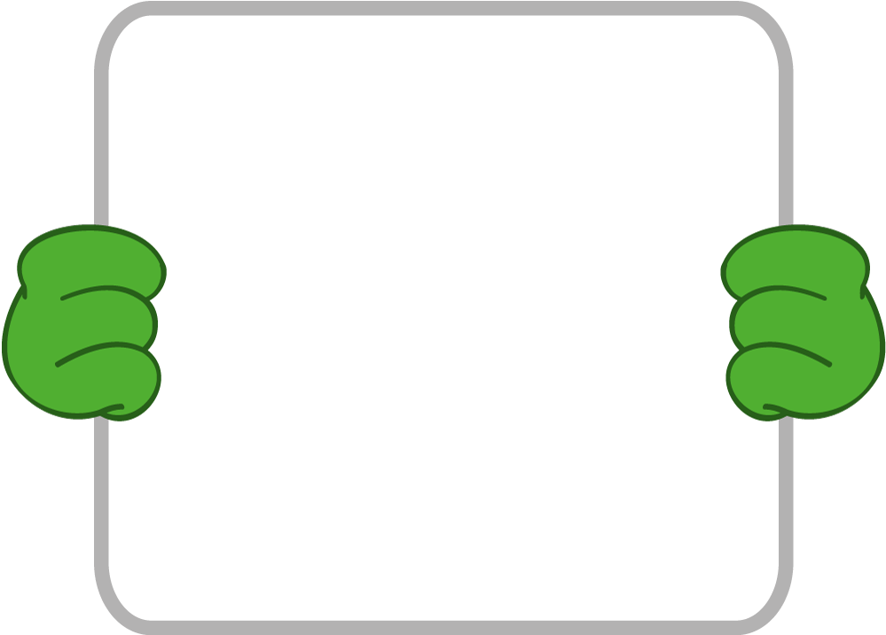
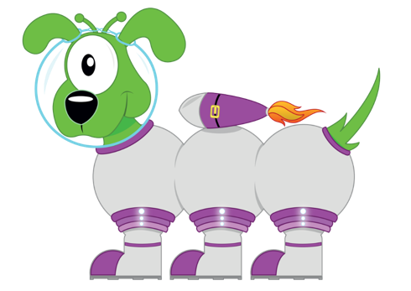
Remember To:
24 + 35
partition the numbers
write out the 2 new questions
add the ones
add the tens
add the ones answer to the tens answer
20 + 30
4 + 5
50
9
59
2
4
3
5
24 + 35 ?
20
4
30
5

Slide 4
Remember To:
24 + 35
partition the numbers
write out the 2 new questions
add the ones
add the tens
add the ones answer to the tens answer
20 + 30
4 + 5
50
9
59
F
A
B
24 + 35 ?

Slide 5
Remember To:
24 + 35
partition the numbers
write out the 2 new questions
add the ones
add the tens
add the ones answer to the tens answer
50
9
59
F
A
B
24 + 35 ?

Slide 6
Remember To:
partition the numbers
write out the 2 new questions
add the ones
add the tens
add the ones answer to the tens answer
50
9
59
F
A
B
24 + 35 ?

Slide 7
Remember To:
partition the numbers
write out the 2 new questions
add the ones
add the tens
add the ones answer to the tens answer
59
F
A
B
24 + 35 ?

Slide 8
Remember To:
partition the numbers
write out the 2 new questions
add the ones
add the tens
add the ones answer to the tens answer
Example 2

Slide 9
Get your whiteboards ready!

Slide 10
Remember To:
32 + 46
partition the numbers
write out the 2 new questions
add the ones
add the tens
add the ones answer to the tens answer
30 + 40
2 + 6
70
8
78
3
4
2
6
32 + 46 ?
30
40
2
6

Slide 11
Remember To:
32 + 46
partition the numbers
write out the 2 new questions
add the ones
add the tens
add the ones answer to the tens answer
30 + 40
2 + 6
70
8
78
F
A
B
32 + 46 ?

Slide 12
Remember To:
32 + 46
partition the numbers
write out the 2 new questions
add the ones
add the tens
add the ones answer to the tens answer
70
8
78
F
A
B
32 + 46 ?

Slide 13
Remember To:
partition the numbers
write out the 2 new questions
add the ones
add the tens
add the ones answer to the tens answer
70
8
78
F
A
B
32 + 46 ?

Slide 14
Remember To:
partition the numbers
write out the 2 new questions
add the ones
add the tens
add the ones answer to the tens answer
78
F
A
B
32 + 46 ?

Slide 15
Remember To:
partition the numbers
write out the 2 new questions
add the ones
add the tens
add the ones answer to the tens answer
Example 3

Slide 16
Get your whiteboards ready!

Slide 17
Remember To:
54 + 32
partition the numbers
write out the 2 new questions
add the ones
add the tens
add the ones answer to the tens answer
50 + 30
4 + 2
80
6
86
3
2
5
4
54 + 32 ?
30
2
50
4

Slide 18
Remember To:
54 + 32
partition the numbers
write out the 2 new questions
add the ones
add the tens
add the ones answer to the tens answer
50 + 30
4 + 2
80
6
86
F
A
B
54 + 32 ?

Slide 19
Remember To:
54 + 32
partition the numbers
write out the 2 new questions
add the ones
add the tens
add the ones answer to the tens answer
80
6
86
F
A
B
54 + 32 ?

Slide 20
Remember To:
partition the numbers
write out the 2 new questions
add the ones
add the tens
add the ones answer to the tens answer
80
6
86
F
A
B
54 + 32 ?

Slide 21
Remember To:
partition the numbers
write out the 2 new questions
add the ones
add the tens
add the ones answer to the tens answer
86
F
A
B
54 + 32 ?

Slide 22
Remember To:
partition the numbers
write out the 2 new questions
add the ones
add the tens
add the ones answer to the tens answer
Question 1

Slide 23
Get your whiteboards ready!

Slide 24
25 + 42 =
Remember To:
partition the numbers
write out the 2 new questions
add the ones
add the tens
add the ones answer to the tens answer
20 + 40
5 + 2
How do you know?

Slide 25
Remember To:
partition the numbers
write out the 2 new questions
add the ones
add the tens
add the ones answer to the tens answer
Question 2

Slide 26
Get your whiteboards ready!

Slide 27
41 + 37 =
Remember To:
partition the numbers
write out the 2 new questions
add the ones
add the tens
add the ones answer to the tens answer
40 + 30
1 + 7
How do you know?

Slide 28
Remember To:
partition the numbers
write out the 2 new questions
add the ones
add the tens
add the ones answer to the tens answer
Question 3

Slide 29
Get your whiteboards ready!

Slide 30
36 + 52 =
Remember To:
partition the numbers
write out the 2 new questions
add the ones
add the tens
add the ones answer to the tens answer
30 + 50
6 + 2
How do you know?

Slide 31
Remember To:
partition the numbers
write out the 2 new questions
add the ones
add the tens
add the ones answer to the tens answer
Question 4

Slide 32
Get your whiteboards ready!

Slide 33
55 + 24 =
Remember To:
partition the numbers
write out the 2 new questions
add the ones
add the tens
add the ones answer to the tens answer
50 + 20
5 + 4
How do you know?

Slide 34
Remember To:
partition the numbers
write out the 2 new questions
add the ones
add the tens
add the ones answer to the tens answer
Question 5

Slide 35
Get your whiteboards ready!

Slide 36
47 + 51 =
Remember To:
partition the numbers
write out the 2 new questions
add the ones
add the tens
add the ones answer to the tens answer
40 + 50
7 + 1
How do you know?

Slide 37
Remember To:
partition the numbers
write out the 2 new questions
add the ones
add the tens
add the ones answer to the tens answer
F
A
B

Slide 38
Get your whiteboards ready!

Slide 39
42 + 36 =
Remember To:
78
partition the numbers
write out the 2 new questions
add the ones
add the tens
add the ones answer to the tens answer
70
8
How do you know?
Question 1
78

Slide 40
Get your whiteboards ready!

Slide 41
24 + 45 =
Remember To:
69
partition the numbers
write out the 2 new questions
add the ones
add the tens
add the ones answer to the tens answer
60
9
How do you know?
Question 2
69

Slide 42
Get your whiteboards ready!

Slide 43
54 + 32 =
Remember To:
86
partition the numbers
write out the 2 new questions
add the ones
add the tens
add the ones answer to the tens answer
80
6
How do you know?
Question 3
86

Slide 44
Get your whiteboards ready!

Slide 45
63 + 14 =
Remember To:
77
partition the numbers
write out the 2 new questions
add the ones
add the tens
add the ones answer to the tens answer
70
7
How do you know?
Question 4
77

Slide 46
Get your whiteboards ready!

Slide 47
52 + 46 =
Remember To:
98
partition the numbers
write out the 2 new questions
add the ones
add the tens
add the ones answer to the tens answer
90
8
How do you know?
Question 5
98

Slide 48
Remember To:
partition the numbers
write out the 2 new questions
add the ones
add the tens
add the ones answer to the tens answer
F
A
B

Slide 49
Get your whiteboards ready!

Slide 50
Remember To:
34 + 52 =
86
partition the numbers
write out the 2 new questions
add the ones
add the tens
add the ones answer to the tens answer
How do you know?
86
Question 1

Slide 51
Get your whiteboards ready!

Slide 52
Remember To:
25 + 63 =
88
partition the numbers
write out the 2 new questions
add the ones
add the tens
add the ones answer to the tens answer
How do you know?
88
Question 2

Slide 53
Get your whiteboards ready!

Slide 54
Remember To:
45 + 24 =
69
partition the numbers
write out the 2 new questions
add the ones
add the tens
add the ones answer to the tens answer
How do you know?
69
Question 3

Slide 55
Get your whiteboards ready!

Slide 56
Remember To:
53 + 42 =
95
partition the numbers
write out the 2 new questions
add the ones
add the tens
add the ones answer to the tens answer
How do you know?
95
Question 4

Slide 57
Get your whiteboards ready!

Slide 58
Remember To:
78 + 21 =
99
partition the numbers
write out the 2 new questions
add the ones
add the tens
add the ones answer to the tens answer
How do you know?
99
Question 5

